Slide 1

Lund University, Sweden
Education, research and innovation since 1666
Comparison of energy efficiency between macro and micro cells using energy saving schemes
Koustubh Sharma
Supervisors:
Zhi Zhang
Examiner:
Maria Kihl
Notes:
Comparison of energy efficiency between macro and micro cells using energy saving schemes.

Slide 2
Introduction
ICT industry in total is responsible for as much carbon emissions as aviation industry. And, cellular networks are among the main energy consumers in the ICT industry.
Last year in Germany alone mobile network operators spent more than 200 million Euros on electricity bills and 80% of that cost was from cellular networks. And, as per the EU regulations the cost of electricity is likely to increase more in coming years.
In the new era of internet of things and connected cars these cellular networks are likely to densify furthermore so, there is a pressing need to focus on energy consumption by these networks.

Slide 3
There are various approaches for densifying the present network that we have; in this project we have made comparison between macro cells versus micro cells centric deployment the approaches to cater to the traffic demands with macro cells versus micro cells deployments.

Slide 4
Problem formulation
According to the power model and previous studies the power of femto and pico cells does not vary with varying load or traffic. So, the power consumption in the Power amplifier remains the same.
In connected cars micro cells will be extensively used across both the sides of the roads in 5G.
Need to study the comparison between the macro centric and micro centric deployment.

Slide 5
We will setup a dense urban real like scenario in our simulator and compare the energy efficiencies between macro cells centric deployment versus a micro cells centric deployment.
We will make use of energy- saving schemes like micro DTX, lean carrier and MBSFN to cut the power consumed in the network. We will compare between the deployments with the units like energy per bit, power per unit area and power consumed over a day.
With results presented in this thesis, we will contribute to the understanding of how these cells behave in a realistic traffic scenario and how much gains can we achieve by implementing the above-mentioned energy-saving schemes.

Slide 6
To keep the results more generic and not specific to any particular set of radio base stations we will carry out EARTH power model.

Slide 7
Theory
SMALL CELL BASICS
MICROCELL
MACROCELL
Microcells cover areas less than a mile in diameter and can often be seen mounted on signs, traffic lights, etc. They can be used temporarily during large events for additional coverage.
Comparatively, the traditional cell towers you are used to seeing cover about 20 miles.
Notes:
Macro Cells
These cells are the base stations that provide coverage to a large area with Inter Site Distance (ISD) from hundreds of meters to several kilometers. depending upon the density. They fulfill the baseline coverage for any LTE network, providing connectivity and up all the time. The power consumption varies from 100W to 300W ; they have sectored antennas normally covering 120 degrees per sector.
Micro Cells
Micro cells have lower transmit power than macro BSs, they are smaller base stations with full features that are used to cover both indoor and outdoor crowded areas. It can typically cover a range of few meters to one or two kilometers. The power consumption ranges from 10W to 40W. They are generally used for indoor purposes as well as outdoor such as hot-spots. [11]
I made S and D in capitals. As it is an abbreviation
W in caps after 100 and no full stop after 300W.
No… can be… made active voice

Slide 8
Power distribution in base station
Notes:
The PA connects to the antennas of the base station after providing the required power gain The PA has poor power efficiency as it is made to work in non-saturated region which is to avoid nonlinear distortion from channel interference. In macro BS digital pre-distortion is used to improve the PA efficiency [7].
Radio Frequency module is used to convert analog signals to digital signals. Base Band module serves as digital signal processor for digital up and down conversion of signals, it also does OFDM modulation of the signal. Typical functionalities for BB are filtering, FFT for OFDM modulation and IFFT for OFDM demodulation, signal detection, channel estimation, it acts as the brain of transceiver [13].

Slide 9
Power distribution in different cells
Notes:
Figure shows the breakdown of power consumption in various base stations [15]. We can see over here that the macro base station consumes the most energy in PA in macro cells; whereas base band becomes the major component in small cells.

Slide 10
Variable load power consumption of BS.
BS type | N_{TRX} | P_{max}[W] | P₀[W] | Δ_{p} | P_{sleep}[W]
Macro | 6 | 20 | 130.0 | 4.7 | 75.0
RRH | 6 | 20 | 84.0 | 2.8 | 56.0
Micro | 2 | 6.3 | 56.0 | 2.6 | 39.0
Pico | 2 | 0.13 | 6.8 | 4.0 | 4.3
Femto | 2 | 0.05 | 4.8 | 8.0 | 2.9
P : power consumed in the BS
P_{out} :RF output power
P_{max} : maximum load the output power
Notes:
The relation between the RF output power and the power consumed by base stations are roughly linear in nature [14]. The mathematical equation of this relation could be represented as:
This represents the linear approximation of the power model. Here P would represent the power consumed in the BS and P_{out} is the RF output power, at maximum load the output power would be P_{max}. Power consumption at zero load is given by P₀, Δ_{p} represents the slope of the curve. P_{sleep} represents the sleep mode power consumption in the BS when the load is low and N_{TRX} is the number of transceiver chains. Table 3 provides parameters of power model for different BSs [15].

Slide 11
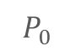
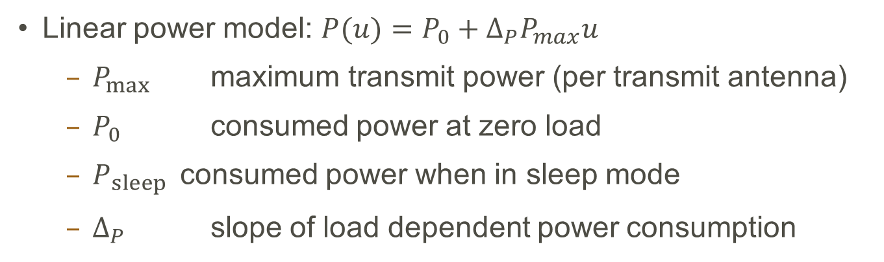
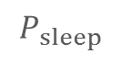
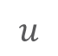

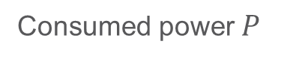
How Much Power Does a Base Station Consume?
Linear power model: $P(u)=P_{0}+{Δ_{P}P}_{max}u$
$P_{max}$ maximum transmit power (per transmit antenna)
$P_{0 }$ consumed power at zero load
$P_{sleep }$ consumed power when in sleep mode
$Δ_{P}$ slope of load dependent power consumption
Consumed power $P$
$$Δ_{P}$$
Load dependent part
$$P_{0}$$
$$P_{sleep}$$
Fixed constant part
0
Resource utilization [%]
100
$$u$$

Slide 12
Average power consumption over a day
Notes:
To get an idea of the power consumption over the entire day, we need to average the power consumed over a day. The simulator which we have uses statistical tools to model the traffic. It measures the networks parameters for a small period of time while keeping the total traffic to be constant. Therefore, to know the network performance over a varied load, we sweep the total traffic value over a sufficient range.
In real scenario the traffic values change over the day in a pattern which is given in [15]. By taking the traffic profile as described in [15] we can estimate the traffic for every hour as a fraction of the peak throughput. Here we take the case of an urban traffic scenario which shows the average pattern of traffic over a day on hourly scale.
Instead of whole; I used entire

Slide 13
Energy Saving schemes
Lean carrier
Micro DTX sleep
MBSFN

Slide 14
Lean carrier
The Lean carrier make use the sleep modes and switching off the cell when there is no transmission of data. It makes use of different features like transmitting the signal only when required, transmitting faster with higher modulation scheme, effectively utilizing the carrier aggregation to have large spectrum and making use of beam forming antennas. These features reduce extraneous signaling and interference.
Minimizing the overhead cell specific reference signaling and using the spectrum flexibility it reduces energy consumption. With lean carrier design, it is possible to achieve fraction of sleep at no load condition to 100%. More details about lean carrier can be found in [16].

Slide 15
Micro DTX sleep
The radio’s RRU component does not transmit all the time. There are time slots when the radio can be put to sleep mode depending upon the traffic handled and the scheduled transmissions. At this point the biasing of the final stage amplifiers is turned off, which can be achieved by sending a strobe signal based on the information of the data that DU needs to send. This information is sent in a message that gives the symbols which will be sent over the radio during the transmission time interval [17].
The LTE RRU transmits 140 OFDM symbols per radio frame consisting of cell-specific radio signal (CSRS) and physical downlink control channel (PDCCH). Assuming a no-load situation when there are no scheduled users; out of 140 OFDM symbols, power amplifier could be put in sleep mode for 73 of them with 37 wake up events. This equals to 4.1ms of sleep time during each radio frame or 41% of time.

Slide 16
MBSFN
In a LTE radio frame six out of ten sub-frames can be Multicast and Broadcast Single-Frequency Network (MBSFN) for FDD system [18]. The MBSFN sub-frames are used to predict the future traffic load for a base station. Using MBSFN a base station could calculate the load it needs to handle in subsequent frames and the resources required to cater to the traffic. This load prediction is made based upon the previously served load information exchanged between the base stations over X2 interface. Load prediction is used to turn off the idle resources and setup the switch off intervals. Moreover, the MBSFN sub-frames have less number of reference signals than normal sub-frames, which gives an opportunity to turn off these sub-frames when there is no data available. [19]
Using MBSFN scheme in no load condition we get 91 OFDM symbols with 19 wake up events per radio frame. This gives a window of 5.9ms or 59% with sleep mode enabled.

Slide 17
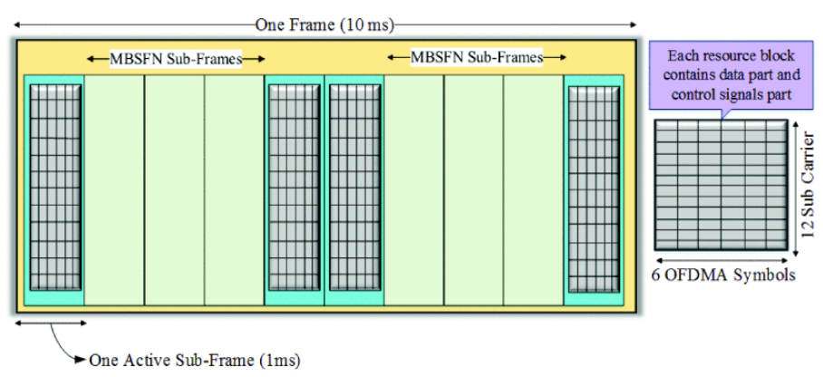
LTE radio frame

Slide 18
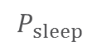

Discontinuous Transmission
Consumed power $P$
Power
saving
$$P_{sleep}$$
Resource utilization [%]
Center resource blocks
1.4 MHz
On
Sleep
Time
Radio-frame 10ms

Slide 19
Discontinuous Transmission
Micro DTX
MBSFN DTX
Lean Carrier DTX
Radio-frame 10ms
MBSFN sub-frames

Slide 20
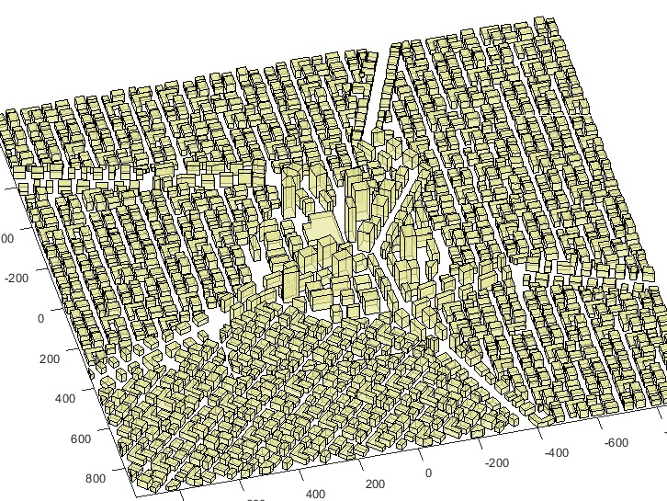
Simulation Scenario
Notes:
The simulator used is Ericsson’s internal network simulator. It is a time static system level simulator implemented in MATLAB. It provides various propagation models from statistical models to ray-tracing based models [12]. The model used in our thesis makes use of statistical model that determines the utilization of the base stations running on a particular load. The utilization values are used to calculate of the power being consumed by the whole network.
Setup
We setup a “real like” dense city scenario, in which we are deploying the city with streets, buildings, base stations and users. The deployment is made keeping in mind of a typical dense urban network with high-rise buildings in the center and lesser dense and low height buildings outer wards. This sort of setup is very close to a realistic scenario than just being a statistical propagation analysis.
We are simulating with ray-tracing propagation model called BEZT. It makes use of multipath propagation model that calculates the path gain between the user and the base station. The channel gains over these paths are stored in a huge gain matrix which are used to estimate the throughput for every user, in the central part of the map

Slide 21
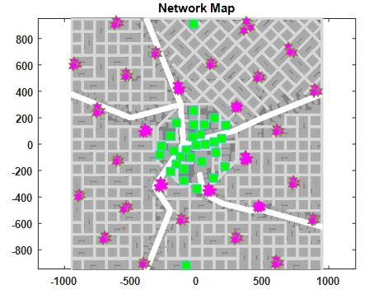
Simulation Scenario
Notes:
We are deploying a real like city scenario in which the outer layer of macro grid will provide baseline coverage, we will refer to it as surrounding macro layer. In first scenario, we deploy macro cells in the city center complemented by the surrounding macro grid and in second scenario we deploy small micro cells in the city center complemented by the surrounding macro grid.
In the first scenario setup, we have taken 21 macro cells deployed in the central grid of the city with inter-site distance of 200m surrounded by a base layer of macro cells with inter-site distance of 400m.
In the second scenario setup, we have taken 28 micro cells deployed in the central grid of the city with a base layer of macro cells inter-site distance of 400m.
The system under consideration is a LTE network with carrier frequency of 2 GHz, highest modulation scheme is 64 QAM, each site has three-sectors. The central grid area is 1000x1000m.
For macro cells; the max Output Power out per antenna in DL is 40 W, P₀ = 130W, Δ_{p} = 4.7 and P_{sleep} = 75.0.
For micro cells; the max Output Power out per antenna in DL from the micros is 10 W, P₀ = 56W, Δ_{p} = 2.6 and P_{sleep} = 39.0.

Slide 22
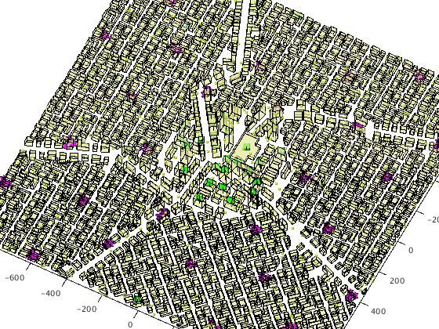
Simulation Scenario

Slide 23
Simulation parameters
Parameter | Value
Carrier frequency | 2.0 GHz
Bandwidth | 20 MHz
Modulation scheme | 64 QAM
Packet traffic model | Equal buffer model
Macro TX Power | 40 W per sector
Micro TX Power | 10 W
Macro cells in central grid | 21
Micro cells in central grid | 28
Feeder loss | 10 dB
Notes:
We deploy buildings, streets, base stations and users in the simulator. The simulator calculates the SINR between each user and node deployed on macro or micro layer. Using the propagation model, the interference, gain or the propagation loss is calculated for each link. To simulate the dynamic network where the download sessions by users happens at random; equal buffer traffic model is utilized. Each session is of fixed file size where the request comes as per the Poisson distribution. The users fully utilize the link bit rate during the file download. The total air traffic could be given by offered traffic per m². Because of the capacity limitations the served traffic is lower than offered traffic. In the simulations, we sweep through varying loads of offered traffic and make use of the served traffic to compare performances.

Slide 24
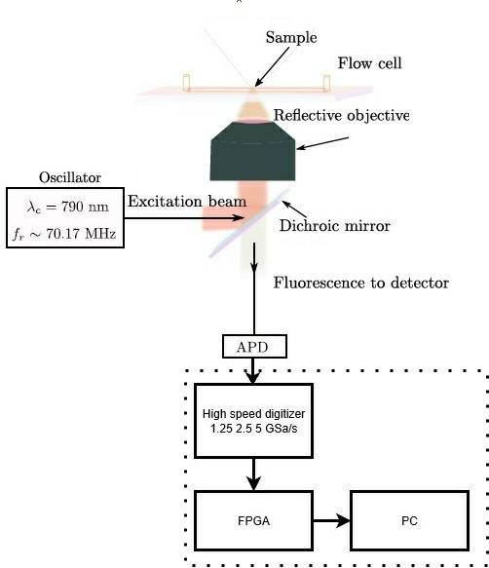
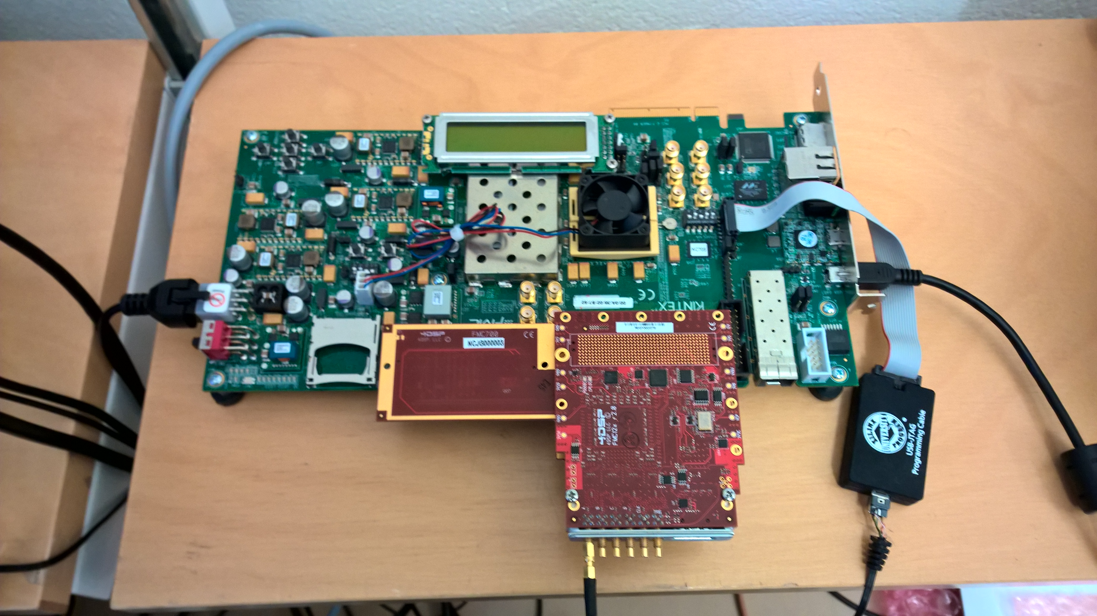
Labratory setup
Ti:Sapphire oscillator: tune 650:1100nm,infrared
APD210 MenloSystems GmbH: 400-1000nm 1.6Ghz

Slide 25
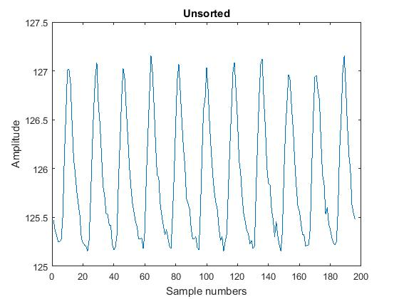
Test
Rhodamine 6G
Averaged
Unsorted
196 Samples
First and last sample
Notes:
22 waves 392 samples

Slide 26
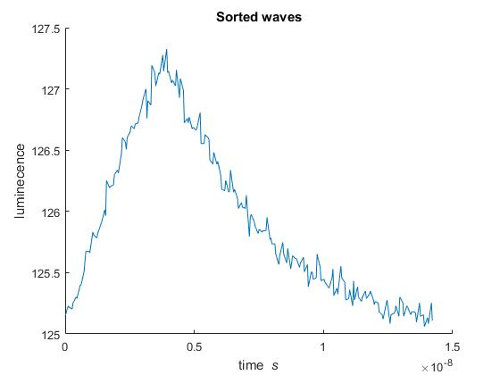
Test
Observations
Frequency, FFT
FMC125 (ADC)
Bits per sample.
Optimal number of waves?
Weak signal.
Data
16 383 Samples.
13.1064μs capture time.
Effective sampling rate of 13,75GSa/s

Slide 27
Future Work
Combine “Frequency Tracking Using Digital Cavities” with this technique.
Upgrade FPGA card.
Continuous sampling/ pipeline the hardware.
Filter
Improve the sorting algorithm.
Notes:
“Real-time Implementation Of Digital Cavity”, Siyuan Fu, Aohan Jin
“Frequency Tracking Using Digital Cavities”, FREDRIK ZETTERBLOM

Slide 28
Summary
Algorithm Fast efficient.
13μs, 100k times faster than TCSPC.
Measure lifetimes existing in μs
Technique usable on any repetitive signal

